Slide 1
ZB Rewards
Registered users analysis

Slide 2
Data preparation
User base - Thamayanthy’s user list
Removed users without mysph hash id
Removed test users (e.g. name contains ‘test’ or email contains ‘test’)
Cleaned the mistyped emails (e.g. sawsenghuat@gmail.com/sawsenghuat@gmal.com)
Cleaned incorrect emails (e.g. ztlp@g.kl)
In the end there are 13937 emails
The definition of registered ZB rewards user - reg_zb flag is a flag that both zb rewards user and registered user (not necessarily registered because of zb rewards)
Pageview base
Extracted the pageviews for both Web and App of SG ZB from Oct 19 to Aug 20

Slide 3
Data preparation
User Tracking
FullvisitorID (GA identifier)
App
(e.g. 12957457920030651985, 6521101761609992835)
Web
(e.g. 5296190368320460541, 8375235547897480259)
Registered Email
(e.g. liangdong85@gmail.com)
MySPH Hash
(e.g. cQ13jxgHZ108DBel191NnnCHY8CVKomKldyt3uks5EE=)
RedShift
Google Analytics/BigQuery
From the registered email, we can get the MySPH Hash, and as long as the user logged in once we can have Fullvisitorid of the corresponding email. This is how we can backtrack the user’s history even before they became registered, and track their readership even when they are not logged in thru GA identifiers.

Slide 4
Overall Users

Slide 5
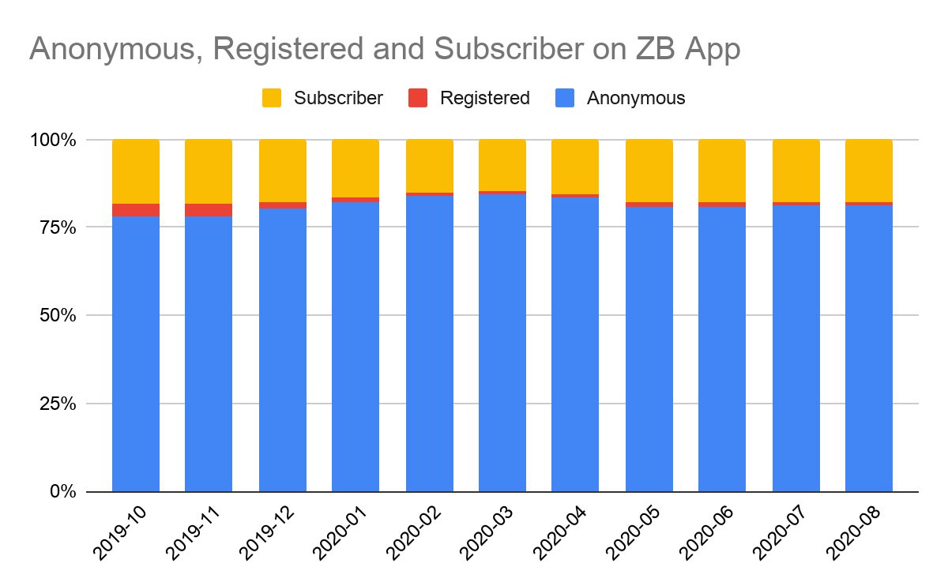
Active Users per month by login status (ZB App)
 | App user distribution
 | Anonymous | Registered | Subscriber | Total
2019-10 | 125993 | 5579 | 29542 | 161114
2019-11 | 127497 | 5693 | 29663 | 162853
2019-12 | 126497 | 2856 | 27752 | 157105
2020-01 | 143547 | 2389 | 28838 | 174774
2020-02 | 170801 | 2129 | 30978 | 203908
2020-03 | 190224 | 2303 | 32679 | 225206
2020-04 | 216198 | 2628 | 40073 | 258899
2020-05 | 201697 | 3113 | 44341 | 249151
2020-06 | 200803 | 2638 | 44739 | 248180
2020-07 | 201198 | 2614 | 43798 | 247610
2020-08 | 187962 | 2017 | 41007 | 230986
On ZB App, the absolute number of logged-in registered and subscriber increased during the ZB rewards period, however proportionally it remained the same level. * There was a spike for logged-in registered users in Oct 19 and Nov 19.

Slide 6
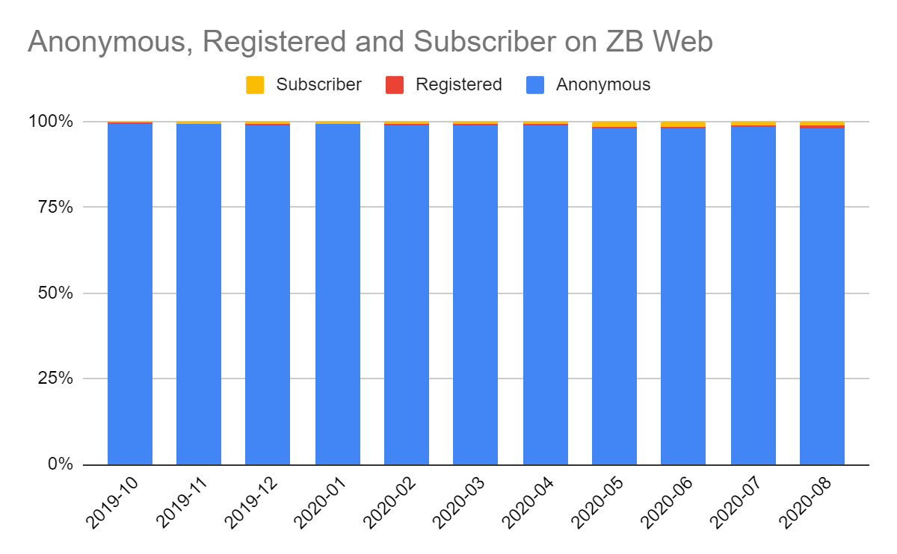
Active Users per month by login status (ZB Web)
 | Web user distribution
 | Anonymous | Registered | Subscriber | Total
2019-10 | 2299769 | 4525 | 8749 | 2313043
2019-11 | 2406447 | 4440 | 15317 | 2426204
2019-12 | 2119063 | 3575 | 17256 | 2139894
2020-01 | 2462915 | 4010 | 19806 | 2486731
2020-02 | 2947445 | 4591 | 27454 | 2979490
2020-03 | 3511498 | 5702 | 31840 | 3549040
2020-04 | 3801066 | 12084 | 35123 | 3848273
2020-05 | 2766978 | 12964 | 39487 | 2819429
2020-06 | 2558830 | 11860 | 39815 | 2610505
2020-07 | 2707745 | 10250 | 35753 | 2753748
2020-08 | 2457528 | 18252 | 32126 | 2507906
On ZB Web, the absolute number of logged-in registered and subscriber increased during the ZB rewards period, however proportionally it remained the same level.

Slide 7
Acquisition impact

Slide 8
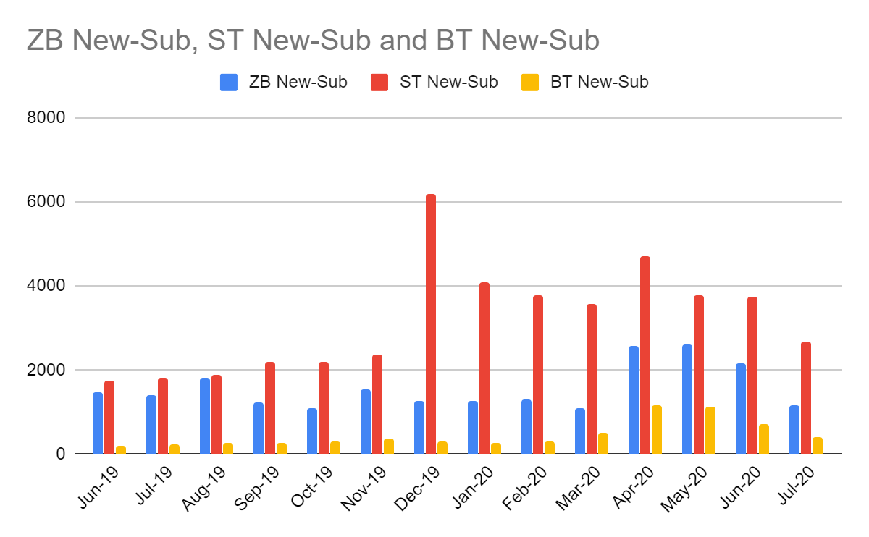
Number of new subs per month
ZB saw increases in subs during covid / ZB rewards period.
ST and BT also saw increases in subs during the covid period.
Recommendation:
To improve how we attribute subscriptions to ZB rewards (i.e. to include subscribe/register button on rewards CTA / pages)
Covid-19
CB
ZB Rewards
GE2020

Slide 9
Engagement

Slide 10
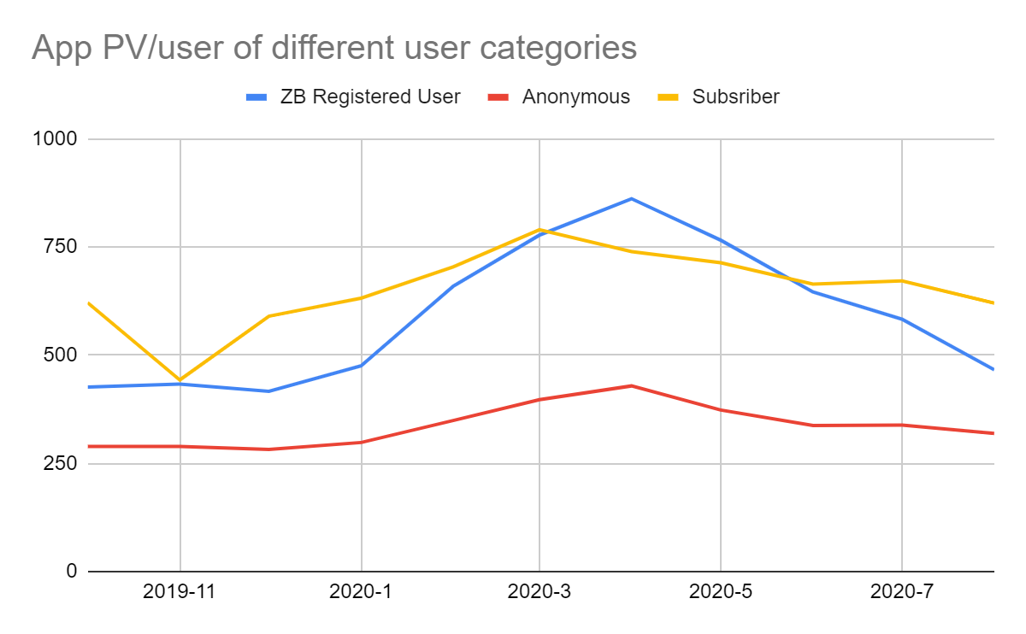
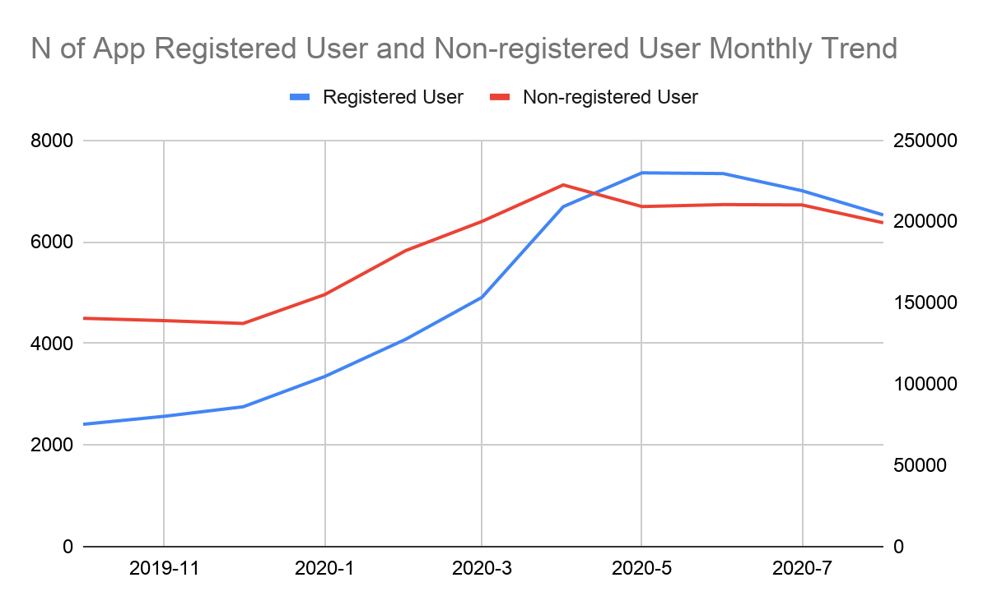
Impact of ZB rewards on pageviews (ZB App)
The number of both active registered users and anonymous users grows over the ZB rewards period.
The monthly PV per user peaked in Apr 20, however it gradually decreased after May 20.
However the increase is observed across user categories, not only for registered users. The increase was likely caused by multiple factors, especially covid-19 and circuit breaker.
From baseline to the peak, ZB registered users, subscribers and anonymous users saw a 65%, 33% and 25% increase respectively. By the end of the ZB rewards period, it gradually went back to the prior activity level.
Notes:
-- Change non-registered to anon
Title = insights
Sub-title = key results to prove insights
Caption = the chart title

Slide 11
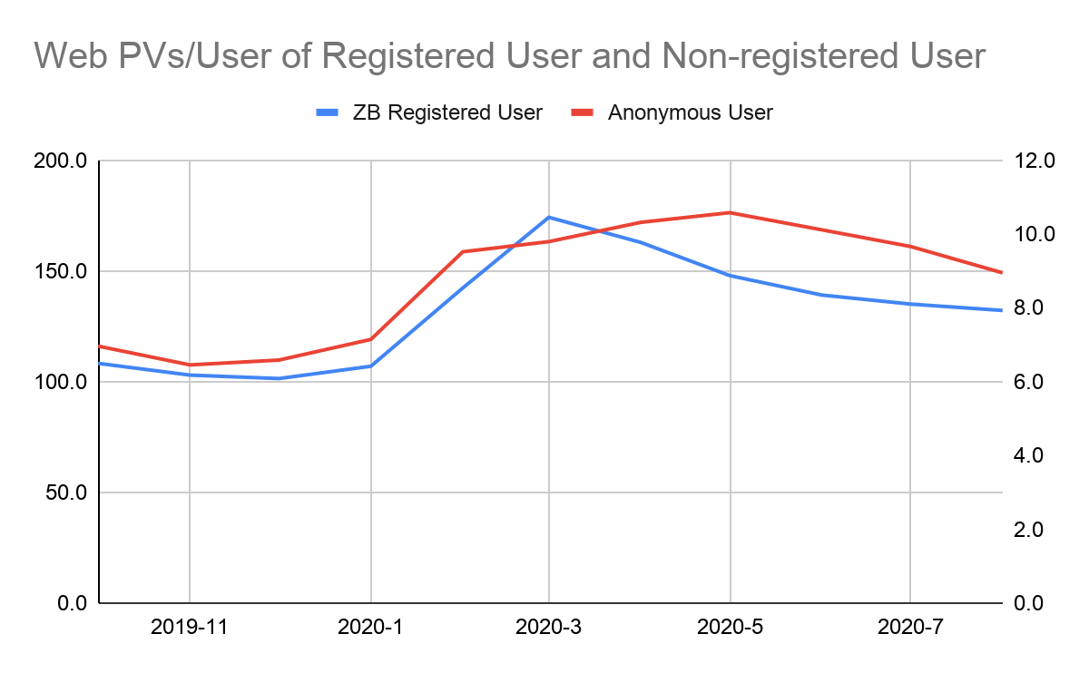
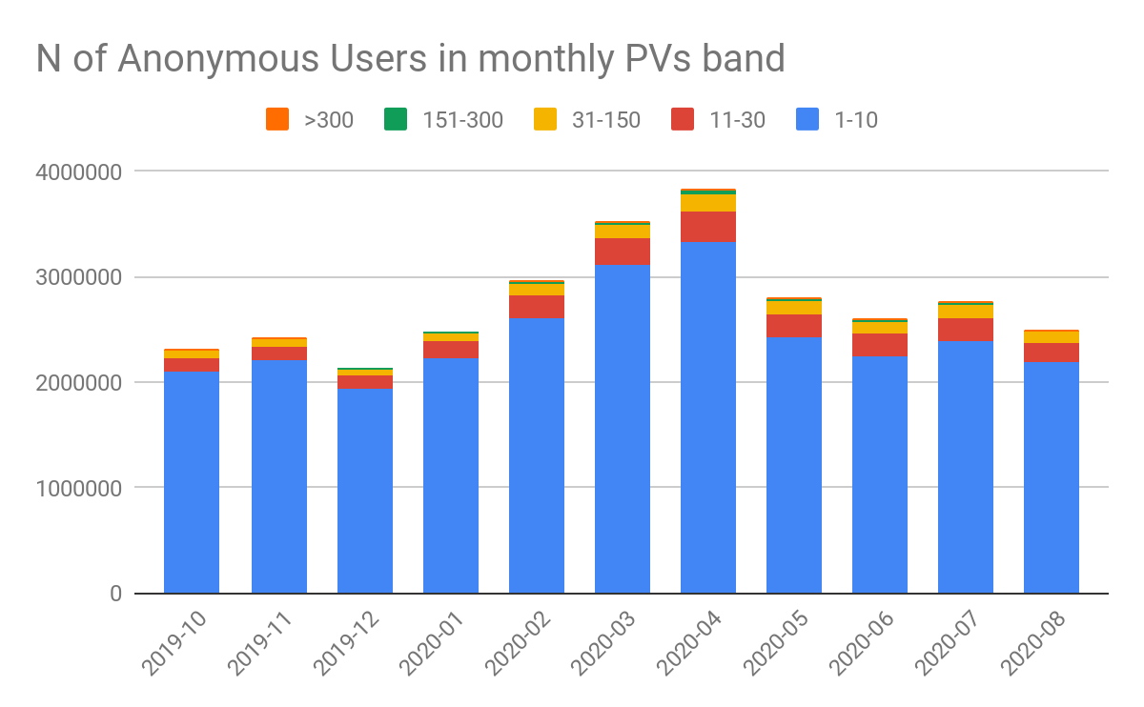
Impact of ZB rewards on pageviews (ZB Web)
Total PVs vs. Time +
Total PVs of three cats
Web PV / active user
>300
151 - 300
31-150
11-30
<10
For the ZB registered users, the monthly PV per user also peaked in Mar 20, however it gradually decreased after Apr 20. The reason why pvs Anonymous user hold better than ZB registered users is because the number is small to begin with and the decrease of users who only come to site occasionally helps the average.

Slide 12
Conclusion
Overall results confounded by covid-19 / circuit breaker
Attribution method of registration / conversions needs to be reviewed
Example: design and implement user journeys such as inclusion of subscribe/register buttons on rewards pages/CTA
Setup for KPI calculation needs to be designed and implemented
Example: need to setup GA to obtain demographics aggregates on registered/converted users who are attributed to ZB rewards

Slide 13
APPENDIX

Slide 14
Age distribution
Google analytics can only provide age statistics on aggregation, and there is no user level demographic info backend.
We can’t extract age info for this batch of users specifically.
However we can pull the age distribution for Anonymous/Registered/Subscriber as a proxy.

Slide 15
Anonymous user group age distribution
Anonymous
Month of Year | 18-24 | 25-34 | 35-44 | 45-54 | 55-64 | 65+
201910 | 46,448 | 207,637 | 207,112 | 146,422 | 83,983 | 71,390
201911 | 51,685 | 219,564 | 218,267 | 152,809 | 87,749 | 73,265
201912 | 39,563 | 177,373 | 189,255 | 153,816 | 90,746 | 61,194
202001 | 59,788 | 185,969 | 161,704 | 130,496 | 80,939 | 44,987
202002 | 93,508 | 305,513 | 280,416 | 221,897 | 128,140 | 83,513
202003 | 113,312 | 364,612 | 320,842 | 262,916 | 193,958 | 141,783
202004 | 118,672 | 380,951 | 318,304 | 272,332 | 244,721 | 153,646
202005 | 94,298 | 259,627 | 209,493 | 224,033 | 173,749 | 101,900
202006 | 84,304 | 231,657 | 197,574 | 187,934 | 161,826 | 90,616
202007 | 98,931 | 234,295 | 212,274 | 168,603 | 179,875 | 113,196
202008 | 88,464 | 200,451 | 181,355 | 181,040 | 155,955 | 141,674

Slide 16
Registered user group age distribution
Registered
Month of Year | 18-24 | 25-34 | 35-44 | 45-54 | 55-64 | 65+
201910 | 146 | 730 | 966 | 617 | 266 | 223
201911 | 159 | 746 | 924 | 484 | 242 | 209
201912 | 138 | 557 | 512 | 293 | 170 | 136
202001 | 148 | 499 | 489 | 283 | 172 | 107
202002 | 263 | 800 | 782 | 490 | 270 | 228
202003 | 289 | 999 | 956 | 540 | 454 | 429
202004 | 635 | 1998 | 2072 | 1092 | 879 | 716
202005 | 897 | 2364 | 1966 | 1388 | 824 | 581
202006 | 750 | 2039 | 1764 | 1166 | 870 | 550
202007 | 558 | 1652 | 1421 | 867 | 833 | 593
202008 | 795 | 1965 | 1670 | 1555 | 1359 | 1302

Slide 17
Subscriber user group age distribution
Subscriber
Month of Year | 18-24 | 25-34 | 35-44 | 45-54 | 55-64 | 65+
201910 | 119 | 353 | 411 | 420 | 351 | 465
201911 | 283 | 919 | 823 | 998 | 705 | 806
201912 | 397 | 1240 | 1077 | 1261 | 1001 | 881
202001 | 415 | 1148 | 996 | 941 | 698 | 492
202002 | 792 | 2496 | 2140 | 1723 | 1182 | 879
202003 | 918 | 2927 | 2305 | 1864 | 1440 | 1247
202004 | 999 | 3178 | 2348 | 2152 | 1717 | 1405
202005 | 1256 | 3915 | 2704 | 2800 | 2055 | 1623
202006 | 1218 | 3951 | 2556 | 2625 | 2210 | 1679
202007 | 1129 | 3069 | 2152 | 2063 | 2080 | 1620
202008 | 1003 | 2523 | 1903 | 2007 | 1846 | 2032

Slide 18
Anonymous user group age distribution
Anonymous
Month of Year | 18-24 | 25-34 | 35-44 | 45-54 | 55-64 | 65+
201910 | 6.05% | 27.03% | 26.97% | 19.06% | 10.93% | 9.29%
201911 | 6.38% | 27.09% | 26.93% | 18.85% | 10.82% | 9.04%
201912 | 5.50% | 24.65% | 26.30% | 21.37% | 12.61% | 8.50%
202001 | 8.92% | 27.75% | 24.13% | 19.47% | 12.08% | 6.71%
202002 | 8.31% | 27.16% | 24.93% | 19.72% | 11.39% | 7.42%
202003 | 8.03% | 25.83% | 22.73% | 18.62% | 13.74% | 10.04%
202004 | 7.87% | 25.27% | 21.11% | 18.06% | 16.23% | 10.19%
202005 | 8.69% | 23.92% | 19.30% | 20.64% | 16.01% | 9.39%
202006 | 8.64% | 23.75% | 20.26% | 19.27% | 16.59% | 9.29%
202007 | 9.65% | 22.85% | 20.71% | 16.45% | 17.55% | 11.04%
202008 | 9.13% | 20.69% | 18.72% | 18.69% | 16.10% | 14.62%

Slide 19
Registered user group age distribution
Registered
Month of Year | 18-24 | 25-34 | 35-44 | 45-54 | 55-64 | 65+
201910 | 0.02% | 0.10% | 0.13% | 0.08% | 0.03% | 0.03%
201911 | 0.02% | 0.09% | 0.11% | 0.06% | 0.03% | 0.03%
201912 | 0.02% | 0.08% | 0.07% | 0.04% | 0.02% | 0.02%
202001 | 0.02% | 0.07% | 0.07% | 0.04% | 0.03% | 0.02%
202002 | 0.02% | 0.07% | 0.07% | 0.04% | 0.02% | 0.02%
202003 | 0.02% | 0.07% | 0.07% | 0.04% | 0.03% | 0.03%
202004 | 0.04% | 0.13% | 0.14% | 0.07% | 0.06% | 0.05%
202005 | 0.08% | 0.22% | 0.18% | 0.13% | 0.08% | 0.05%
202006 | 0.08% | 0.21% | 0.18% | 0.12% | 0.09% | 0.06%
202007 | 0.05% | 0.16% | 0.14% | 0.08% | 0.08% | 0.06%
202008 | 0.08% | 0.20% | 0.17% | 0.16% | 0.14% | 0.13%

Slide 20
Subscriber user group age distribution
Subscriber
Month of Year | 18-24 | 25-34 | 35-44 | 45-54 | 55-64 | 65+
201910 | 0.02% | 0.05% | 0.05% | 0.05% | 0.05% | 0.06%
201911 | 0.03% | 0.11% | 0.10% | 0.12% | 0.09% | 0.10%
201912 | 0.06% | 0.17% | 0.15% | 0.18% | 0.14% | 0.12%
202001 | 0.06% | 0.17% | 0.15% | 0.14% | 0.10% | 0.07%
202002 | 0.07% | 0.22% | 0.19% | 0.15% | 0.11% | 0.08%
202003 | 0.07% | 0.21% | 0.16% | 0.13% | 0.10% | 0.09%
202004 | 0.07% | 0.21% | 0.16% | 0.14% | 0.11% | 0.09%
202005 | 0.12% | 0.36% | 0.25% | 0.26% | 0.19% | 0.15%
202006 | 0.12% | 0.41% | 0.26% | 0.27% | 0.23% | 0.17%
202007 | 0.11% | 0.30% | 0.21% | 0.20% | 0.20% | 0.16%
202008 | 0.10% | 0.26% | 0.20% | 0.21% | 0.19% | 0.21%

